Slide 1






DEV-ON
College Name: GLBITM
Team Name: CodeCrushers
Team Leader Name: Prakhar Agrawal
Team Members Name: Sanchit Kumar Dhiman
Shambhavi Tiwari
Theme: Education

Slide 2

Problem Statement
Education
Fragmented Information
Information and resources are scattered across different platforms and websites.
Lack of Organization
Difficulty in finding structured learning paths and roadmaps.
Limited Accessibility
Lack of access to quality educational resources for all learners.

Slide 3
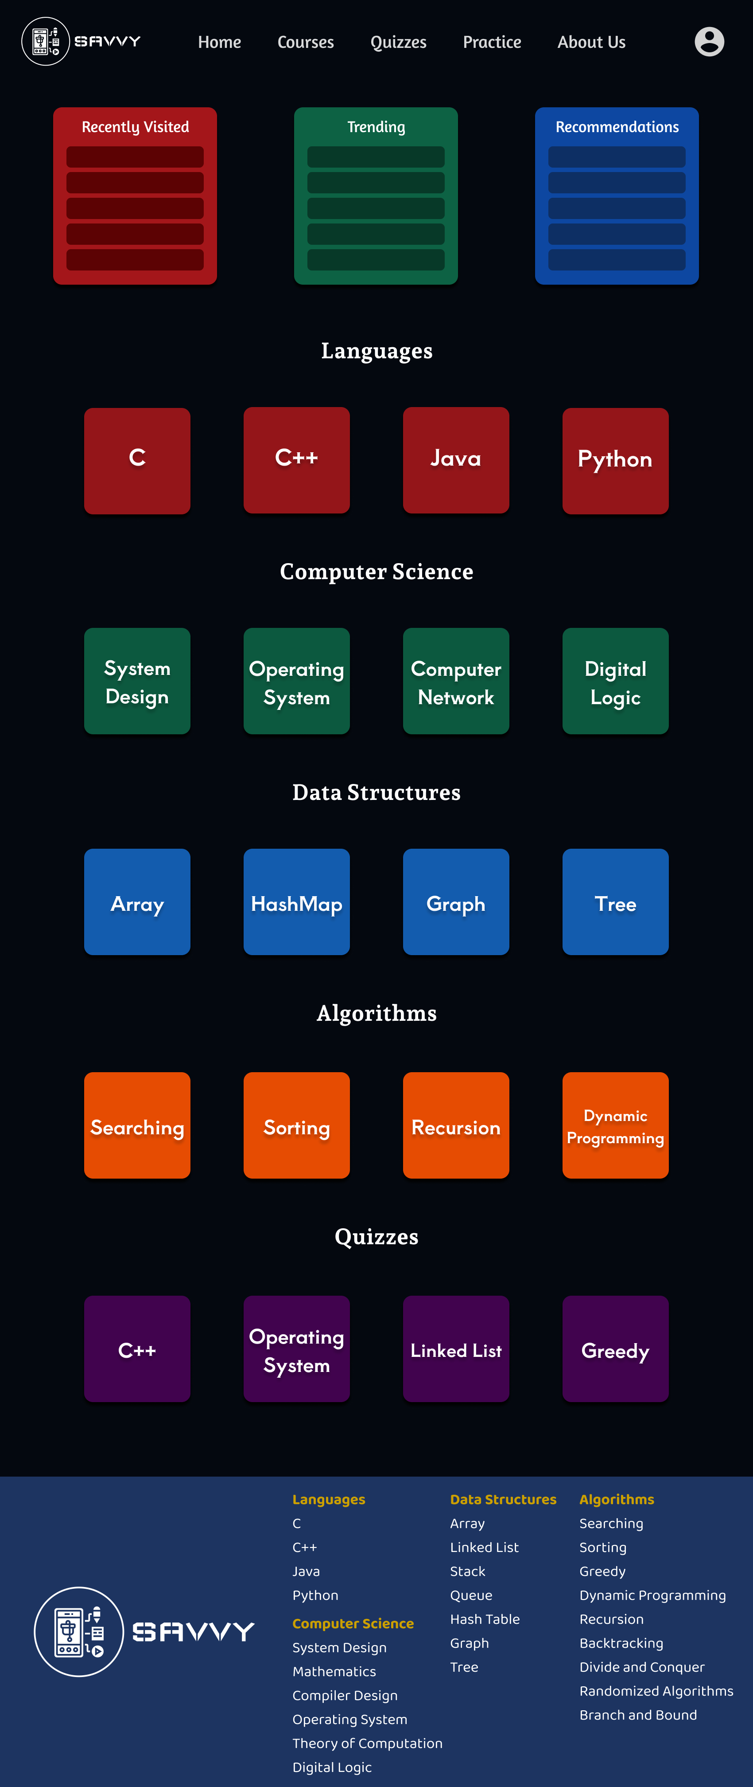
Solution
Features
Roadmaps for different topics.
Structured learning paths.
Curated resources.
Progress tracking.
Resource gathering and recommendations.

Slide 4
Working & Techstack
Working
Users can access the learning platform through a website or web application.
The platform offers learning topics organized in roadmaps.
Users can select a topic and follow a structured step-by-step learning journey.
The platform provides resources, exercises, and assessments to aid learning.
Users can track their progress and earn badges or certifications.

Slide 5
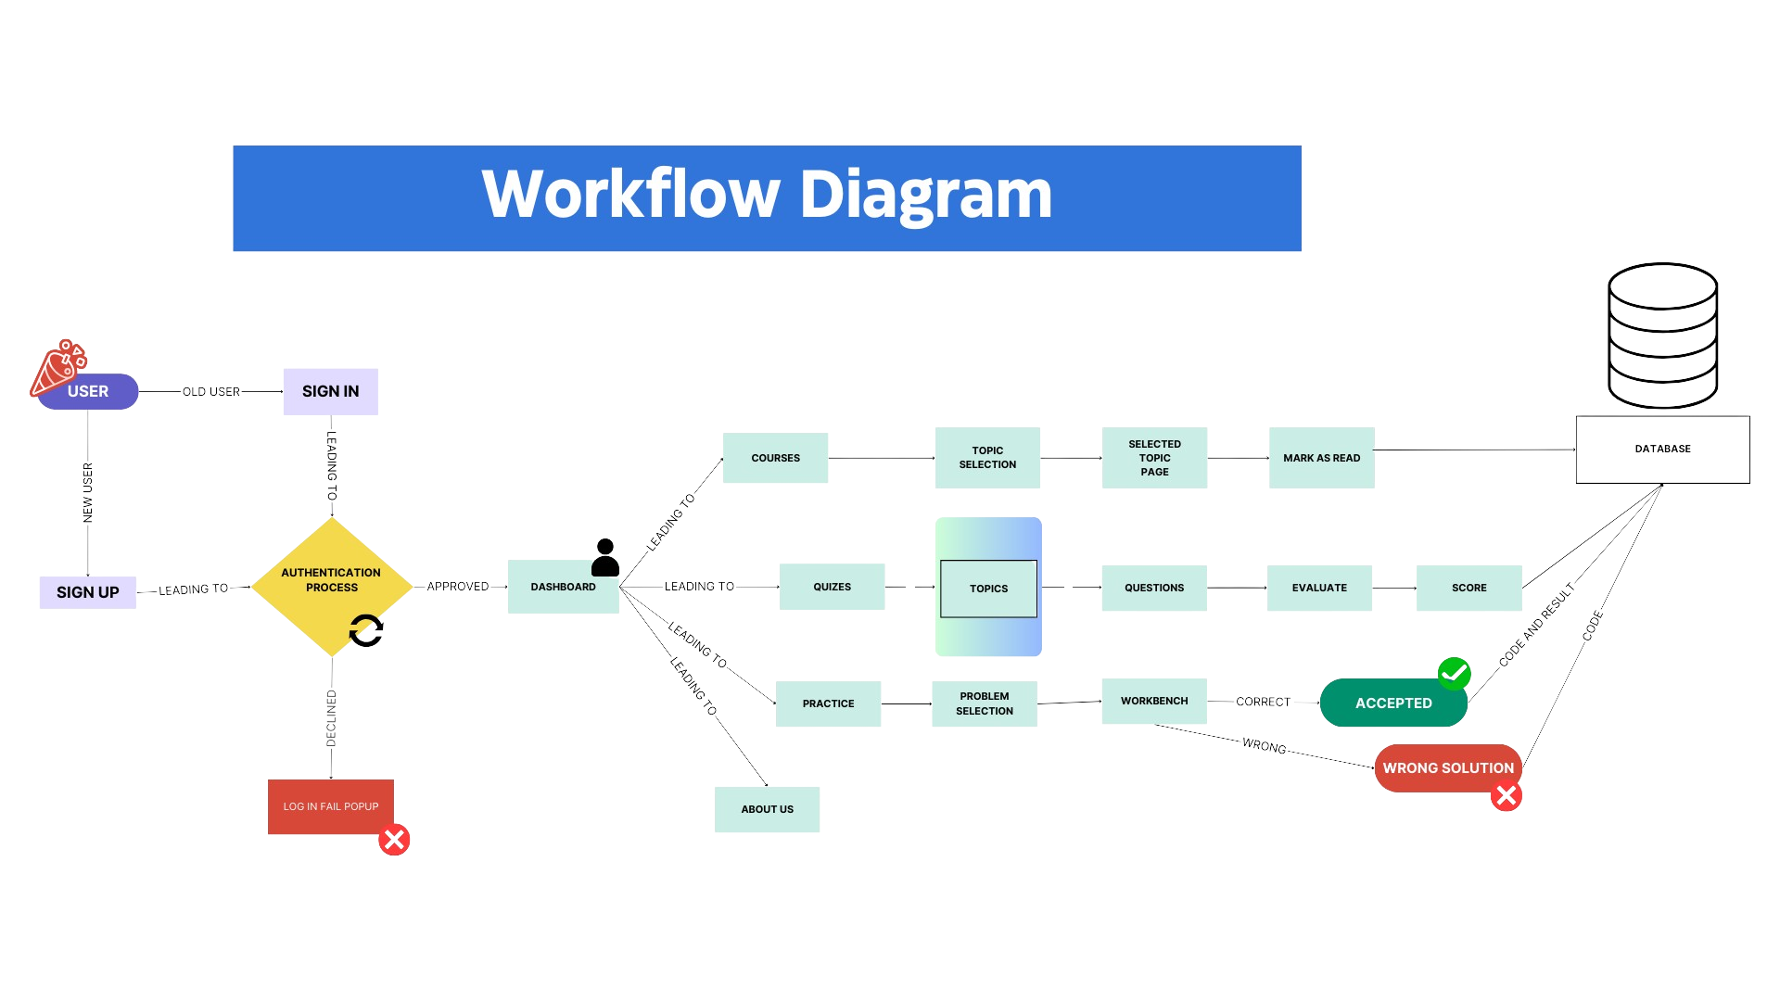
Working & Techstack

Slide 6
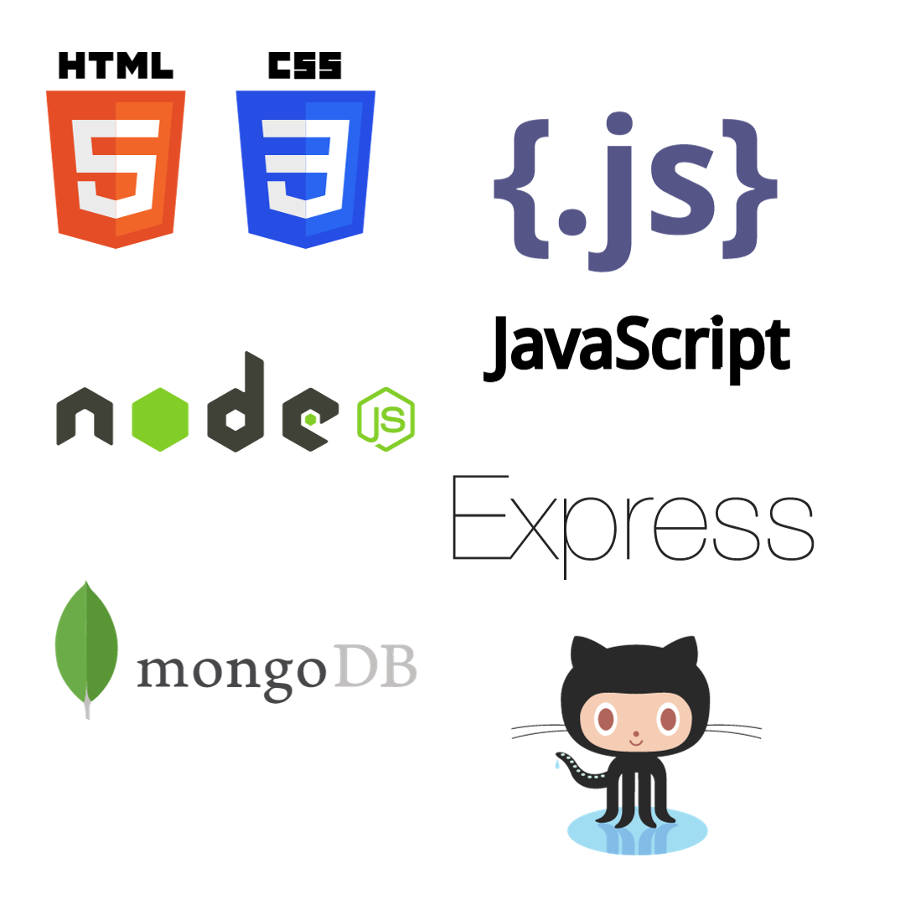
Working & Techstack
TechStack
Front-end:
HTML, CSS, JavaScript
Back-end:
Node.js, Express.js
Database:
MongoDB
Version Control:
GitHub

Slide 7
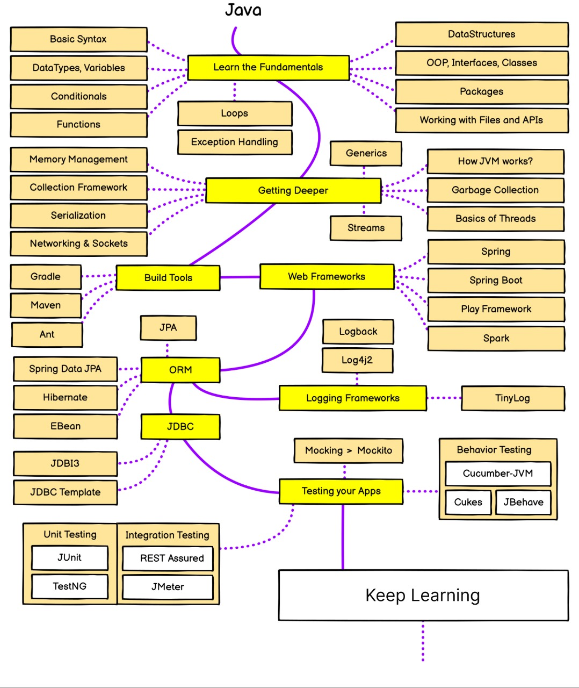
Uniqueness of your idea
Well Structured learning roadmaps tailored to users' goals and interest.
Learning resources for all learning paths integrated at one place.
Interactive quizzes and assessments to track progress and reinforce learning.
Time Saving.

Slide 8
MarketPlace & Impact
Target Audience
Our solution is targeted towards students of all ages and levels who are looking to learn various topics in a structured manner.
Positive Effects on Education
Increased accessibility to educational resources for students worldwide.
Personalized learning experience tailored to individual needs and learning styles.
Empowerment of self-directed learning and independent study.
Encouragement of lifelong learning and continuous skill development.
Facilitation of collaboration and knowledge sharing among learners.
Users don't need to spend time in searching for quality resources on various platforms.

Slide 9
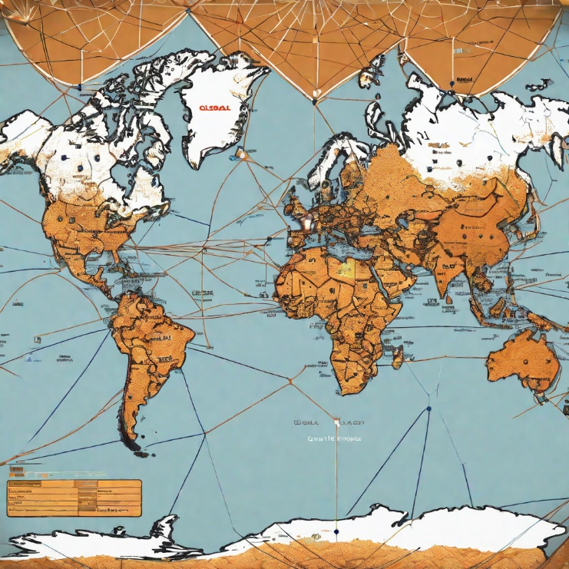


Future Goals
Expanding Our platform
Our future goals include expanding our platform to reach a wider audience.
Partnering with Educational Institutions
We aim to partner with educational institutions and organizations to provide our platform to more students.
Continuous Improvement
We are committed to continuously improving and enhancing our features based on user feedback.

